Slide 1
What kind of venue to open in Paris and where to open it?

Slide 2
Why be interested in opening a venue in Paris ?
Paris is the most visited capital in the World
More than 50 millions tourists every year, a lot of income comes from tourism
Any venue helpful to tourist would generate revenue
What kind of venue and what location to optimise the revenue ?

Slide 3
Data acquisition
Neighborhood list acquired by scraping https://en.wikipedia.org/wiki/Quarters_of_Paris
Coordinates of neighborhood acquired using Geocoder packages
Venues acquired using Foursquare API
No duplicates, not useful columns were droped
Final data contains 2322 rows and 7 columns

Slide 4
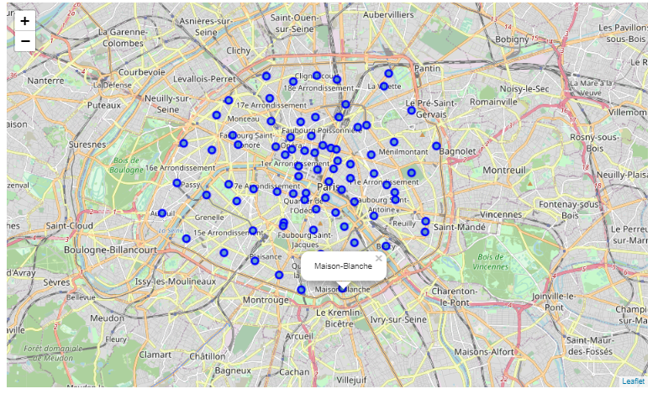
Using Foliuum for visualization
Neighborhood are equally spread, a bit more concentrated in the center

Slide 5
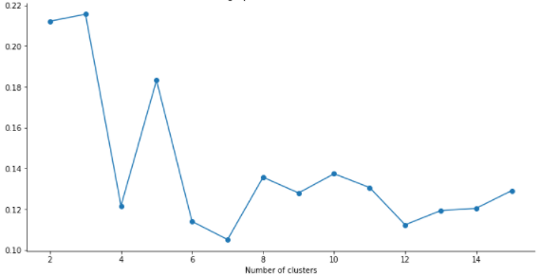
Using Silouhette Score for Clustering
Silouhette Score helped us determine that the optimal number of cluster was 3

Slide 6
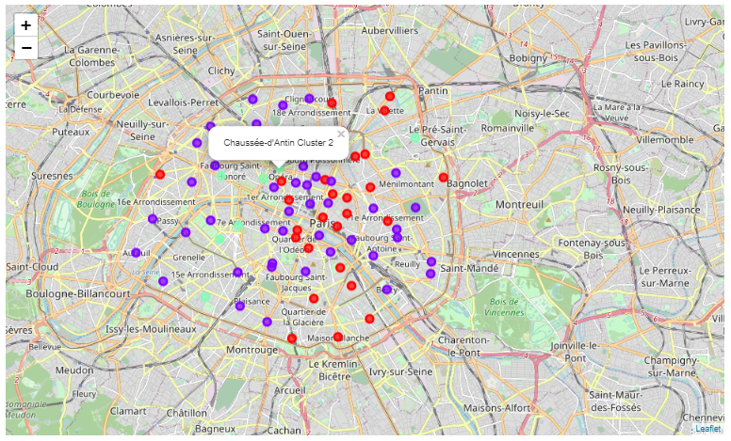
Clustering neighborhood using K-means
3 clusters, using only restaurants venues. Clusters reflects at what point French Cuisine is dominent in the neighborhood

Slide 7
Conclusion and recommandation
This model was built to help locate the perfect place to open a restaurant
French restaurant seems to be the dominant kind
Cluster n°2 shows where French Cuisine is the less dominant
Recommandation is to open a French Restaurant in a neighborhood of Cluster n°2, near to the city center, where there are the most tourists
Recommandation of Chaussée d’Antin or La Madeleine Neighborhood

